Slide 1

Text Classification
Vasuraddi Koliwad

Slide 2

Overview
Research:
Text Classification for Ecommerce Product Categories
Suggested Use case:
- Category classification through product description

Slide 3
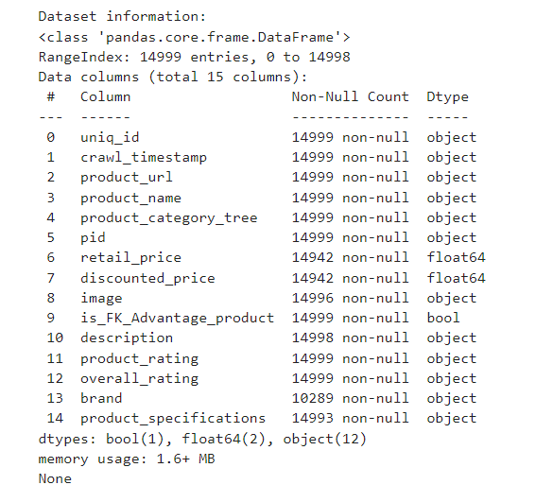
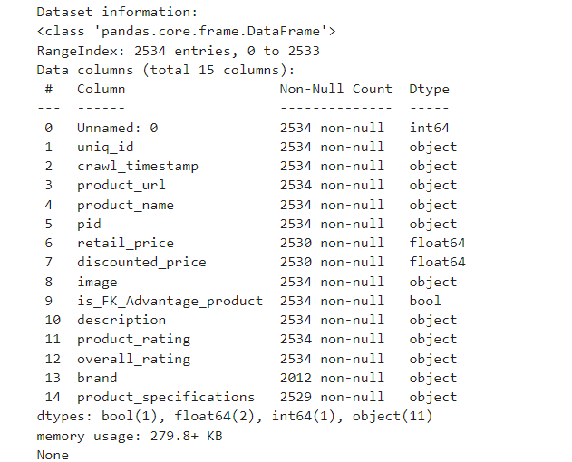
Dataset / Text Corpus
Training Dataset
Test Dataset

Slide 4
Libraries used in the python
Pandas
Numpy
NLTK
Matplotlib
Seaborn
Sklearn

Slide 5
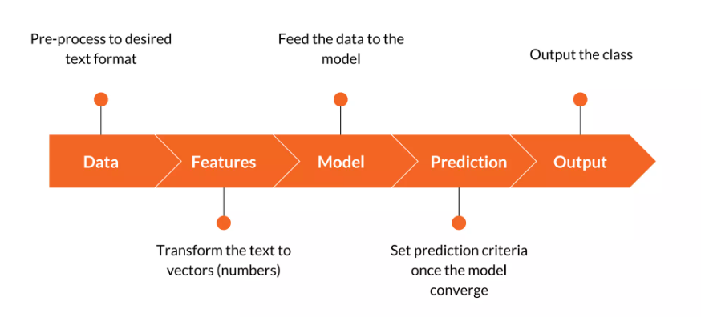
General Process

Slide 6
Model used for prediction
LinearSVC
LogisticRegression
MultinomialNB
RandomForestClassifier

Slide 7
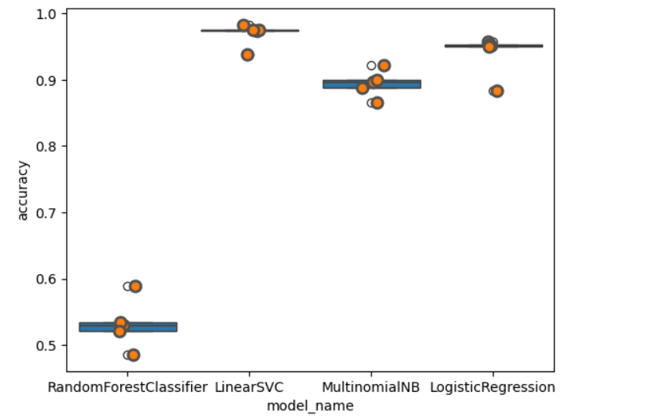
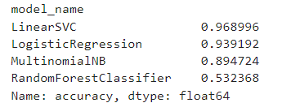
Output – Accuracy Test

Slide 8
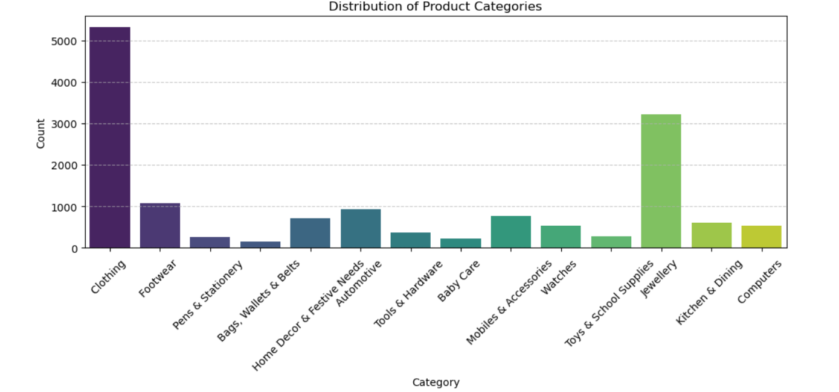
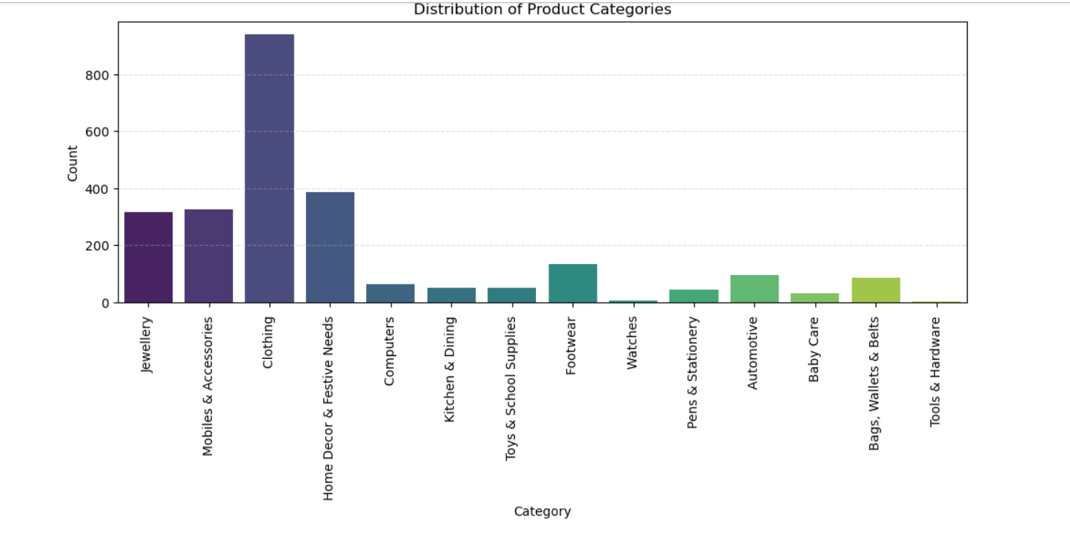
Output – Prediction
Training Dataset
Test Dataset

Slide 9
Thank You

